Slide 1
Message Passing

Slide 2
Buffering
How do message transmitted from one process to another?
Messages can be transmitted from one process to another by copying the body of the message from the address space of the sending process to the address space of the receiving process
Is the receiving process is always ready to receive a message?
In some cases, the receiving process may not be ready to receive a message transmitted to it but it wants the operating system to save that message for later reception.
In these cases, the operating system will rely on the receiver having a buffer in which messages can be stored prior to the receiving process executing specific code to receive the message.

Slide 3
Buffering
The synchronous and asynchronous modes of communication correspond respectively to the two extremes of buffering:
a null buffer, or no buffering
buffer with unbounded capacity.
Other two commonly used buffering strategies are:
single-message buffer
finite-bound or multiple-message, buffers.

Slide 4
Buffering
Null buffer (No buffering)
In case of no buffering, there is no place to temporarily store the message.
Hence one of the following implementation strategies may be used in case of no buffering.(How sender and receiver communicate ?)
Case 1:
The message remains in the sender process's address space and the execution of the send is delayed until the receiver executes the receive().
When the receiver executes receive, an acknowledgment is sent to the sender's kernel saying that the sender can now send the message.
On receiving the acknowledgment message, the sender is unblocked, causing the send() to be executed once again.
This time, The message is successfully transferred from the sender's address space to the receiver's address space (since the receiver is waiting to receive the message).

Slide 5
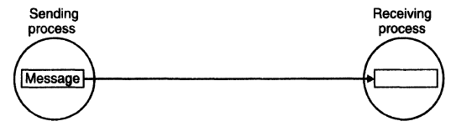
Buffering
Null buffer (No buffering)
Case 2:
After executing send(), the sender process waits for an acknowledgment from the receiver process.
If no acknowledgment is received within the timeout period, it assumes that its message was discarded and tries again hoping that this time the receiver has already executed receive.
Note:
The sender may have to try several times before succeeding.
The sender gives up after retrying for a predecided number of times.
In the case of no buffering, the logical path of message transfer is directly from the sender's address space to the receiver's address space

Slide 6
Buffering
Null buffer (No buffering)
Important points to be noted:
The null buffer strategy is generally not suitable for synchronous communication between two processes in a distributed system.
This is because, if the receiver is not ready, a message has to be transferred two or more times, and the receiver of the message has to wait for the entire time taken to transfer the message across the network.
In a distributed system, message transfer across the network may require significant time in some cases.
Therefore, instead of using the null buffer strategy, synchronous communication mechanisms in network/distributed systems use a single-message buffer strategy.

Slide 7
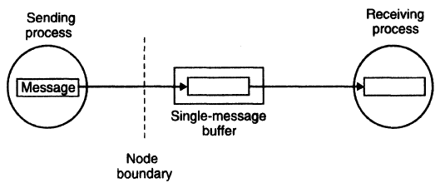
Buffering
Single-Message buffer
In this strategy, a buffer having a capacity to store a single message is used on the receiver's node.
The main idea behind the single-message buffer strategy is to keep the message ready for use at the location of the receiver.
In this method, the request message is buffered on the receiver's node if the receiver is not ready to receive the message.
The message buffer may either be located in the kernel's address space or in the receiver process's address space.
The logical path of message transfer involves two copy operations.

Slide 8
Buffering
Unbounded-Capacity Buffer
In the asynchronous mode of communication, since a sender does not wait for the receiver to be ready, there may be several pending messages that have not yet been accepted by the receiver.
Therefore, an unbounded-capacity message buffer that can store all unreceived messages is needed to support asynchronous communication with the assurance that all the messages sent to the receiver will be delivered.
However, Unbounded capacity of a buffer is practically impossible.

Slide 9
Buffering
Finite-Bound (or Multiple.-Message) Buffer
As Unbounded capacity of a buffer is practically impossible, in practice, systems using asynchronous mode of communication use finite-bound buffers
A strategy is needed for handling the problem of a possible buffer overflow (the buffer has finite bound).
The buffer overflow problem can be dealt with in one of the following two ways:
Unsuccessful communication.
Flow-controlled communication.
Unsuccessful communication:
Message transfers fail whenever there is no more buffer space.
The send normally returns an error message to the sending process, indicating that the message could not be delivered to the receiver because the buffer is full.
Unfortunately, the use of this method makes message passing less reliable.

Slide 10
Buffering
Finite-Bound (or Multiple.-Message) Buffer
Flow-controlled communication:
The second method is to use flow control, which means that the sender is blocked until the receiver accepts some messages, thus creating space in the buffer for new messages.
This method introduces a synchronization between the sender and the receiver and may result in unexpected deadlocks.
Note
The create buffer system call, when executed by a receiver process, creates a buffer (sometimes called a mailbox or port) of a size specified by the receiver.
The receiver's mailbox may be located either in the kernel's address space or in the receiver process's address space.

Slide 11
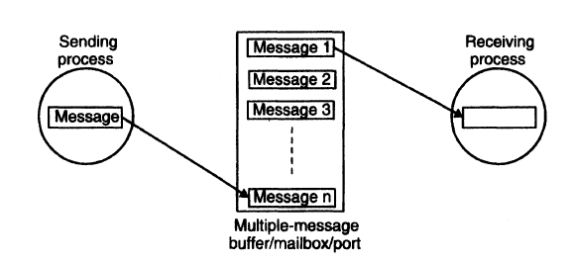
Buffering
Finite-Bound (or Multiple.-Message) Buffer
Note
In the case of asynchronous send with bounded-buffer strategy, the message is first copied
from the sending process's memory into the receiving process's mailbox
then copied from the mailbox to the receiver's memory when the receiver calls for the message.

Slide 12
PROCESS ADDRESSING
Important issue in message-based communication is addressing (or naming) of the parties involved in an interaction.
A message-passing system usually supports two types of process addressing
Explicit addressing
Implicit addressing
Explicit addressing.
The process with which communication is desired is explicitly named as a parameter in the communication primitive used.
Primitive used in Explicit addressing are
send(process_id, message): Send a message to the process identified by “process_id”.
receive(process_id, message): Receive a message from the process identified by “process_id”.

Slide 13
PROCESS ADDRESSING
Implicit addressing.
A process willing to communicate does not explicitly name a process for communication.
Primitive used in Implicit addressing are
Send_any(service_id, message): Send a message to any process that provides the service of type “service_id”.
The sender names a service instead of a process.
This type of primitive is useful in client-server communications when the client is not concerned with which particular server out of a set of servers providing the service.
receive_any(process_id, message): Receive a message from any process and return the process identifier (“process_id”) of the process from which the message was received.
The receiver is willing to accept a message from any sender.
This type of primitive is useful in client-server communications when the server is meant to service requests of all clients that are authorized to use its service.

Slide 14
PROCESS ADDRESSING
Methods to identify a process
By a combination of
machine_id and local_ id, such as machine_id@local_id.
Local id – Process identifier or port identifier – uniquely identifies a process on a machine.
Pros : No need of global coordinator
Cons: Does not support Process migration
2. By a combination of the following three fields:
machineld, local_id, and machineid.
Machine id part is used by sending machine kernel to send msg to receiving process machine.
Used by the kernel of receiver process to forward the msg to the process for which its intended

Slide 15
PROCESS ADDRESSING
The first field identifies the node on which the process is created
The second field is a local identifier generated by the node on which the process is created
The third field identifies the last known location (node) of the process
Link based process addressing.
Machine_id@local_id@machine_id
Drawback
The overhead of locating a process may be large if the process has migrated several times.
It may not be possible to locate a process if an intermediate node is down
Location transparency

Slide 16
PROCESS ADDRESSING
To achieve location transparency in process addressing, two level naming scheme for processes is used.
Each process has two identifiers
high level name – Machine independent (ASCII)
Low level name- Machine dependent (machine_id@local_id)
Sender specifies high level name of receiving process . Sender kernel contacts name server to get low level name. using this kernel sends to proper machine. Receiver kernel delivers to receiving process
Caching is used. (high level name- low level name)
Pros – Suitable for functional addressing –high level name identifies service and name server maps to one or more process that provides service
Cons – Poor reliability and Scalability because name server – centralized. To overcome replicate – Increases overhead.

Slide 17
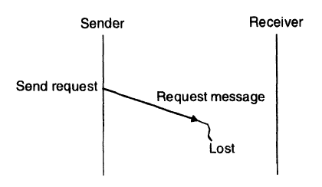
FAILURE HANDLING
Distributed system may be prone to partial failures such as a node crash or a communication link failure.
During interprocess communication, such failures may lead to the following problems:
Loss of request message: This may happen either due to the failure of communication link between the sender and receiver or because the receiver's node is down at the time the request message reaches there

Slide 18
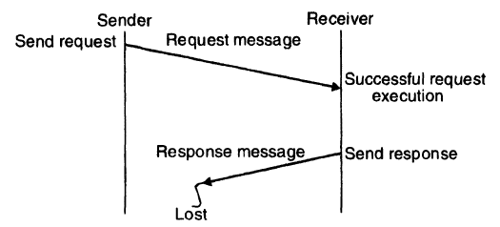
FAILURE HANDLING
During interprocess communication, such failures may lead to the following problems:
Loss of response message. This may happen either due to the failure of communication link between the sender and receiver or because the sender's node is down at the time the response message reaches there.

Slide 19
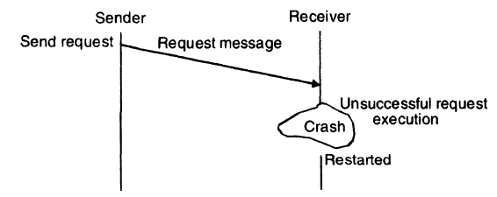
FAILURE HANDLING
During interprocess communication, such failures may lead to the following problems:
Unsuccessful execution of the request: This happens due to the receiver's node crashing while the request is being processed.
To cope with these problems, a reliable IPC protocol of a message-passing system is normally designed based on the idea of:
Internal retransmissions of messages after timeouts and the return of an acknowledgment message to the sending machine's kernel by the receiving machine's kernel.

Slide 20





CLIENT
FOUR WAY PROTOCOL
SERVER
REQUEST
REQ
SUCESSS
SEND ACK
ACK
REPLY (result)
ACK

Slide 21



CLIENT
THREE WAY PROTOCOL
SERVER
REQUEST
REQ
SUCESSS
SEND ACK
REPLY
ACK

Slide 22
Problems
Request processing takes a long time.
Req msg- lost – retransmitted only after timeout (large value)
Timeout value is not set properly (large value) – unnecessary retransmission

Slide 23

CLIENT
TWO WAY PROTOCOL
SERVER
REQUEST
REQ
SUCESSS
SEND ACK
TIMER
REPLY

Slide 24
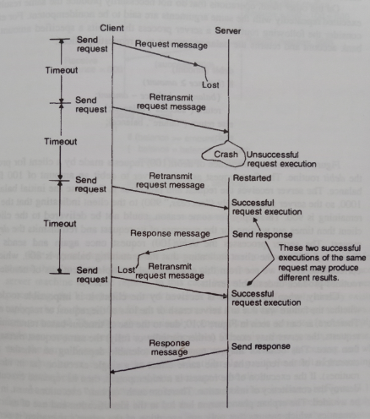

Slide 25


Idempotency and Handling or Duplicate Request Messages
Repeatability
produces the same results with same arguments no matter how many times it is performed.
Eg. Debit(amount)
If(balance>= amount)
Balance=balance-amount;
Return(“Success”, balance);
Else Return(“failure”, balance);
End;

Slide 26
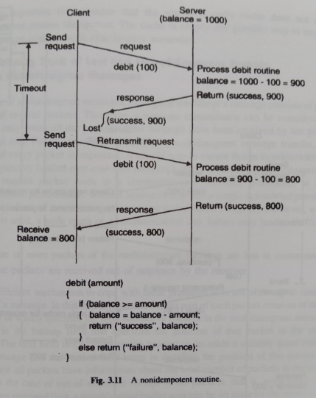

Slide 27
Exactly – once semantics
Can be implemented by using a unique identifier for every client request and set up a reply cache in the kernel address space on server machine

Slide 28
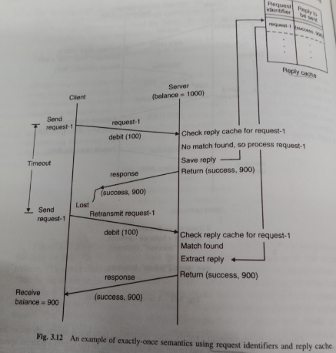

Slide 29


lost and Out-of-Sequence Packets
 For successful completion of a multidatagram message transfer, reliable delivery of every packet is important.
Reliability
Stop and Wait Protocol
Called Blast Protocol
link failure leads to
One or more packet Loss
Packets are received Out of sequence
Ack for each packet
Ack for all

Slide 30
lost and Out-of-Sequence Packets
Packet Header Part two extra fields
First field- Total no of packets in multidatagram msg
Second – bitmap field that specifies the Position of this packet in complete message.
After timeout not all packets are received, bitmap indicating unreceived packets will be sent to sender .Sender retransmits only the packets that is not yet received.
Selective Repeat

Slide 31
